Slide 1

Primitive Types Recap and the String Data Type
In the previous video, we looked at the char, and also the boolean types, which were Java's seventh and eighth data types.
So at this point, you should be familiar with all eight of Java's primitives.
COMPLETE JAVA MASTERCLASS
Primitive Types Recap and the String Data Type

Slide 2
Java's 8 Primitive Data Types
Whole number | Real Number (floating point or decimal)
byte short int long | float double
Single character | Boolean value
char | boolean
The int and a double are Java's default data types for numeric literals
COMPLETE JAVA MASTERCLASS
Primitive Types Recap and the String Data Type

Slide 3
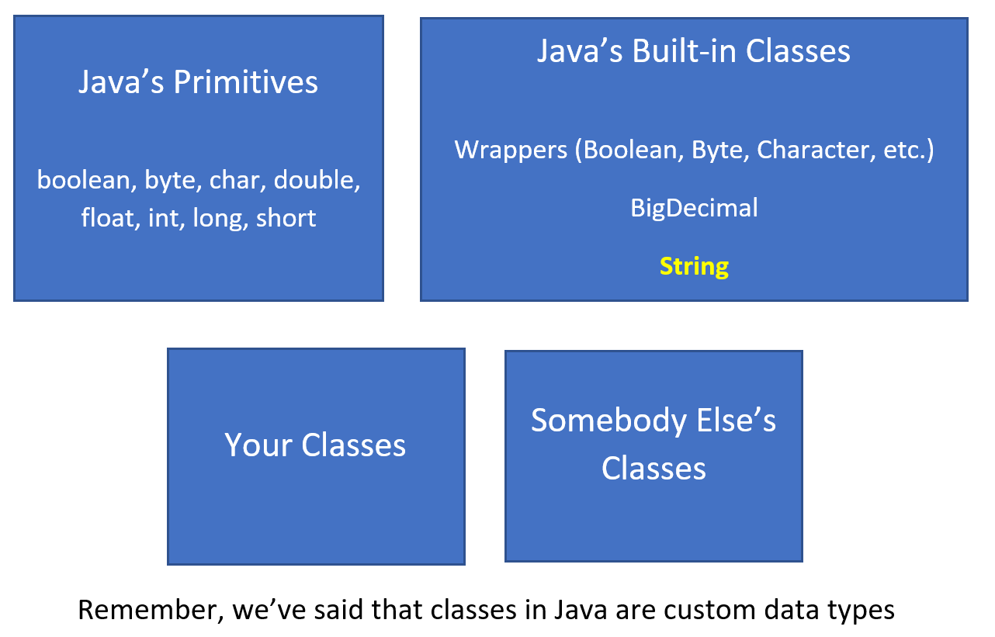
Handling Data in Java
This slide demonstrates that most Java programs use some combination of the data types shown in this diagram.
Remember, I’ve said that classes in Java are custom data types
COMPLETE JAVA MASTERCLASS
Primitive Types Recap and the String Data Type

Slide 4
Handling Data in Java
Remember, I’ve said that classes in Java are custom data types
You'll use Java's primitive data types, Java's built-in classes, and probably some combination of your own custom classes and classes created by other people.
COMPLETE JAVA MASTERCLASS
Primitive Types Recap and the String Data Type

Slide 5
So What is a String?
A String is a class that contains a sequence of characters.
COMPLETE JAVA MASTERCLASS
Primitive Types Recap and the String Data Type

Slide 6
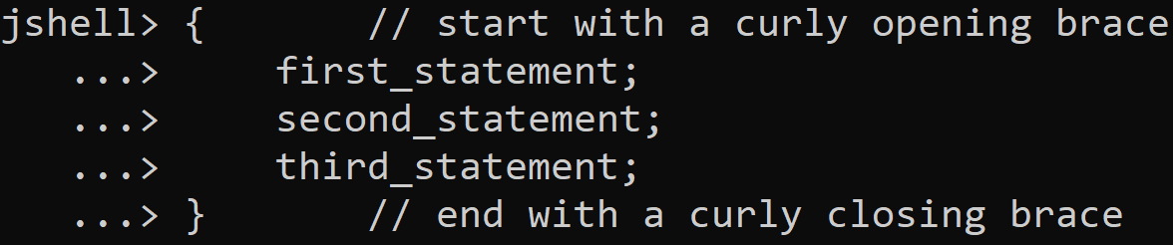
Executing multiple lines of code in JShell
To execute multiple lines of code as a set, in JShell, first start with an opening curly brace and press enter.
JShell will display an alternate prompt as you can see, three dots and a greater than sign.
You can add a statement and press enter, until you've added as many statements as you want to run.
Finally, add the closing curly brace, noting that a semicolon is not required after this brace.
Once you press enter after the closing brace, all of your statements will run in the order you put them.
COMPLETE JAVA MASTERCLASS
Primitive Types Recap and the String Data Type

Slide 7
Executing Multiple Statements In JShell
There are two ways to execute multiple statements in JShell:
Put your statements on a single line.
Or, enclose your statements in a set of curly braces {}.
COMPLETE JAVA MASTERCLASS
Primitive Types Recap and the String Data Type

Slide 8
String concatenation
In Java, the + symbol is an operator which can mean addition, if used for numbers.
But it also means concatenation when applied to a String.
A String + anything else, gives us a String as a result, concatenating anything after the String as text to the initial String.
COMPLETE JAVA MASTERCLASS
Primitive Types Recap and the String Data Type

Slide 9
Strings are Immutable
Immutable means that you can't change a String after it's created.
So in the case of the code we've written, the value 120.47 is technically not appended to the current contents of lastString.
Instead, a new String is created automatically by Java. The new String consists of the previous value of lastString, plus a textual representation of the double value 120.47.
The net result, is that our variable, lastString, has the concatenated value. However, Java created a new String in the process, and the old one will get discarded from memory automatically.
COMPLETE JAVA MASTERCLASS
Primitive Types Recap and the String Data Type

Slide 10
String vs StringBuilder
The String class is immutable, but can be used much like a primitive data type.
The StringBuilder class is mutable, meaning it can be changed, but does not share the String's special features, such as being able to assign it a String literal or use the plus operator on it.
Both are classes, but the String class is in a special category in the Java language.
COMPLETE JAVA MASTERCLASS
Primitive Types Recap and the String Data Type

Slide 11
The String
The String is so intrinsic to the Java language, it can be used like a 9th primitive type.
But it's not a primitive type at all, it's a class.
COMPLETE JAVA MASTERCLASS
Primitive Types Recap and the String Data Type

